Slide 1
Service Management System
Software Engineering Lab Project

Slide 2



Stakeholders
Developer: Saleem Malik(2021-CS-32)
Project Owner: Mahnoor Ijaz(2021-CS-43)
Supervisor: Sir Laeeq Khan Niazi

Slide 3
Agenda
1.
Introduction
6.
Technology Stack
Project Management Tool
2.
3.
Communication Tool
Backend
4.
Wireframes
5.
Frontend
7.
8.
Meeting Minutes
9.
10.
Coding Best Practices
GitHub

Slide 4
Introduction
The aim of this project is to develop a web application which is basically A service Providing Platform like Fiverr from there are two user one is seller and one is buyer seller add his services and buyer place the order to the seller after accepting the offer the order is started. There is real time chat between the seller and the client who place the order.
Database Schema
Project Features

Slide 5
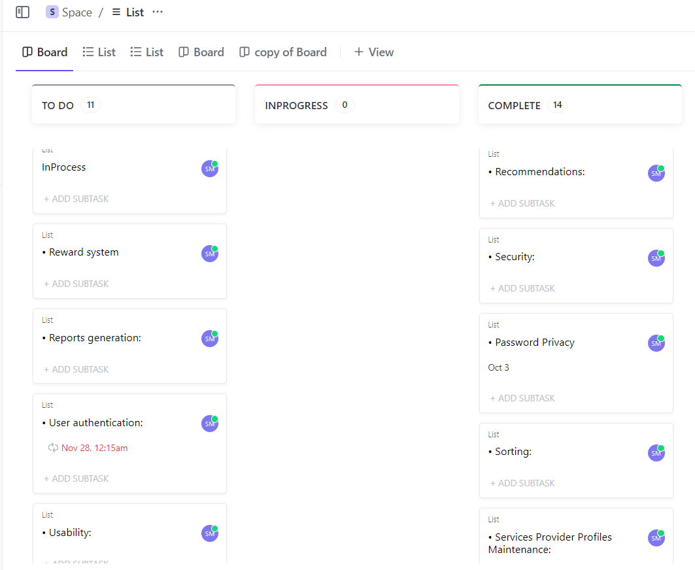
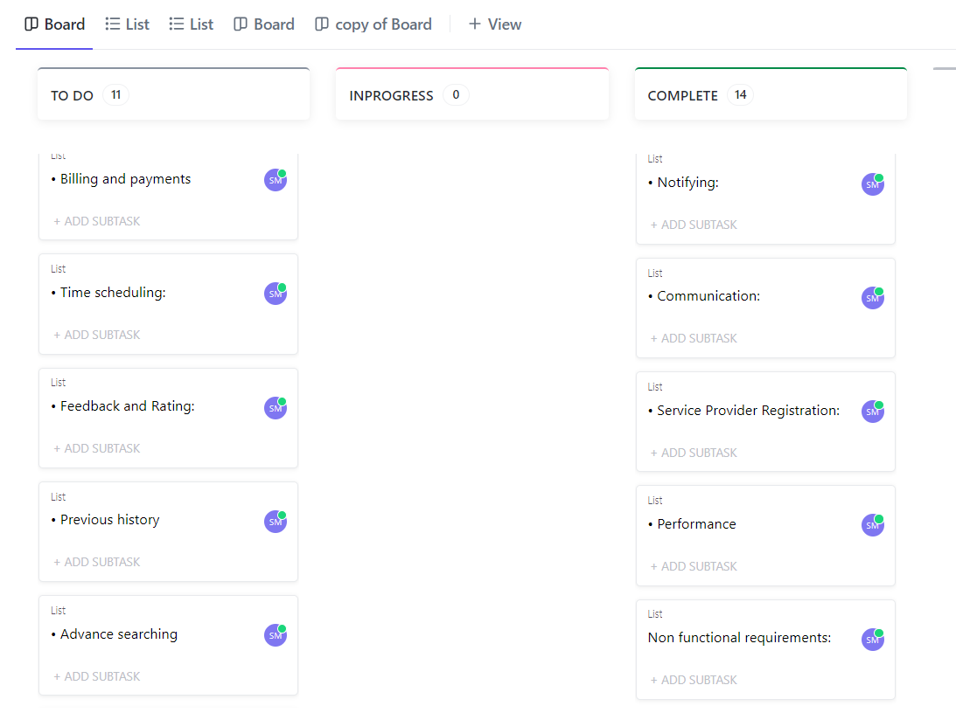
Project Management Tool
Tool Used: Click-Up

Slide 6
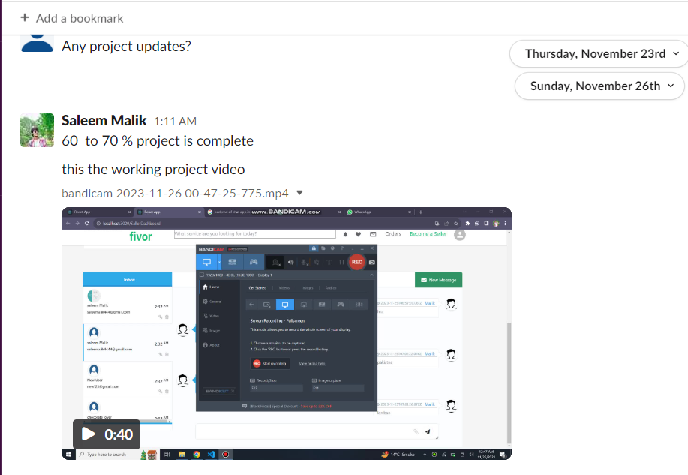
Communication Tool
Tool Used: Slack

Slide 7
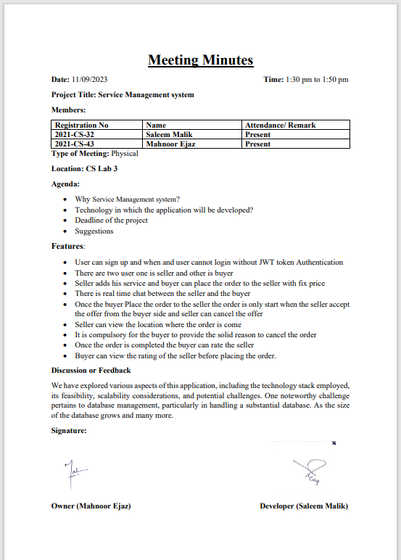
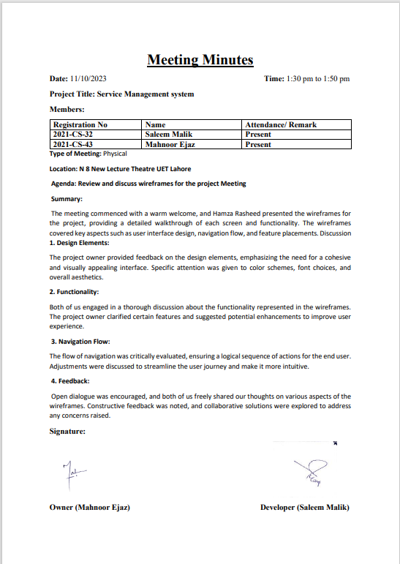
Meeting Minutes

Slide 8
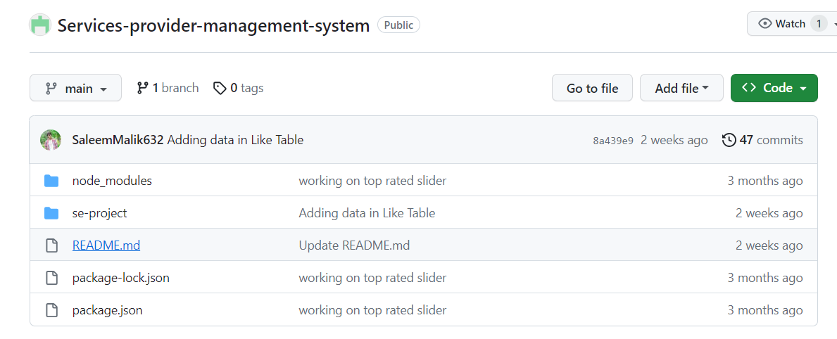
GitHub Repository

Slide 9
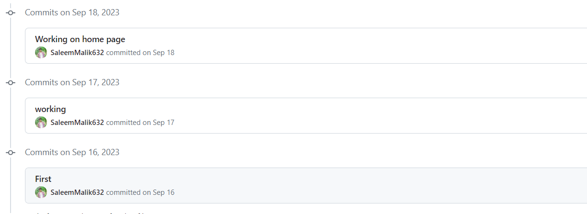
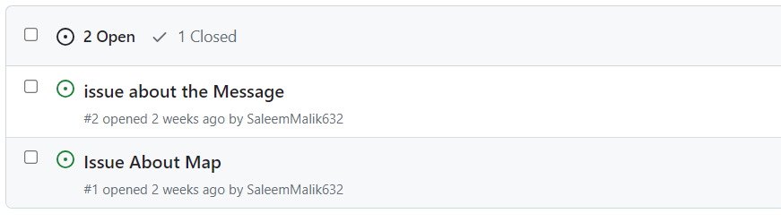
Commit Style and Issues

Slide 10
Technology Stack: MERN
React:
Node.js:
Event-driven and asynchronous nature, provides scalability and responsiveness.
Express.js:
Streamlines server-side development with its lightweight structure, middleware support, and simplified routing.
Modular architecture and virtual DOM ensure efficient and readable code, fostering a dynamic and responsive user interface.
Flexible schema, JSON-like documents.
MongoDB:

Slide 11
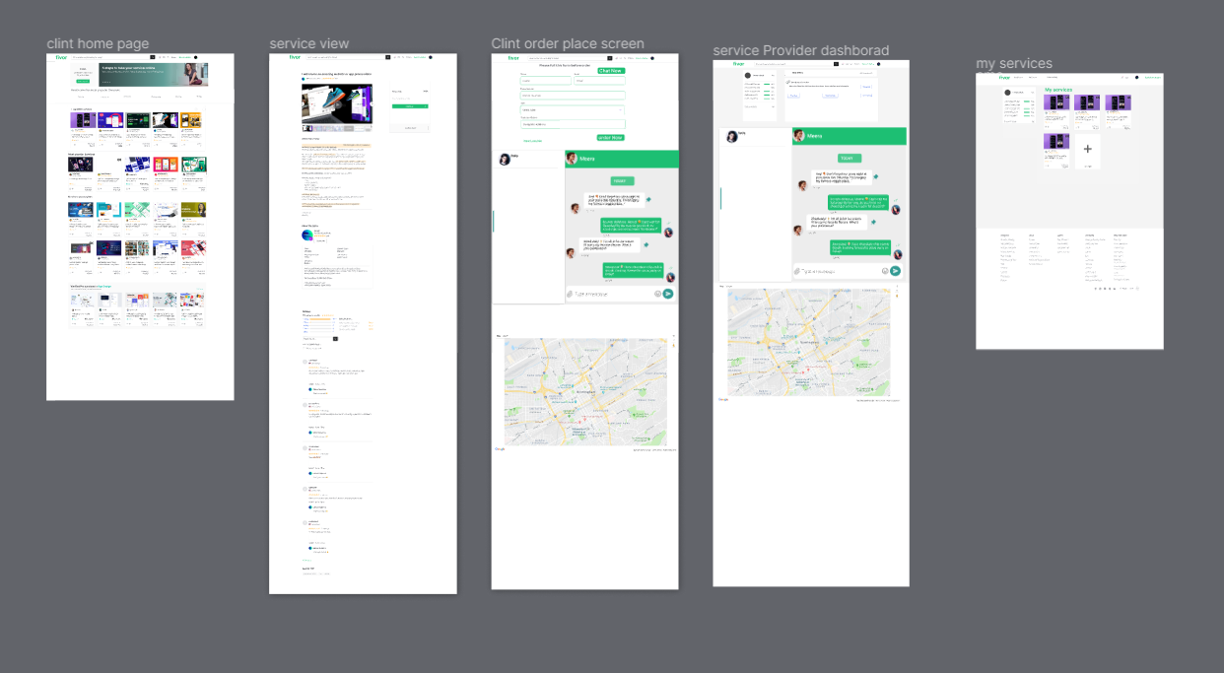
Wireframes

Slide 12
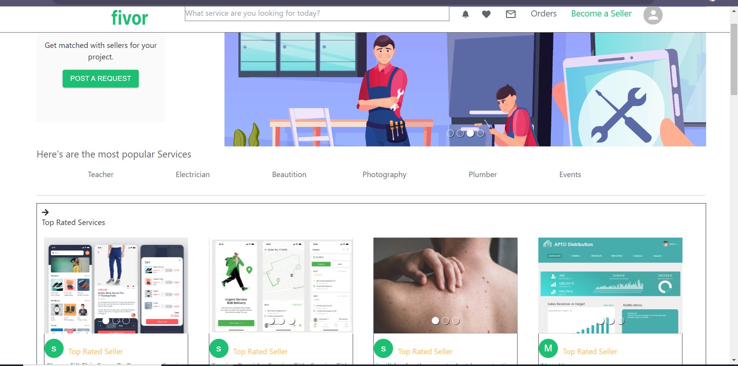
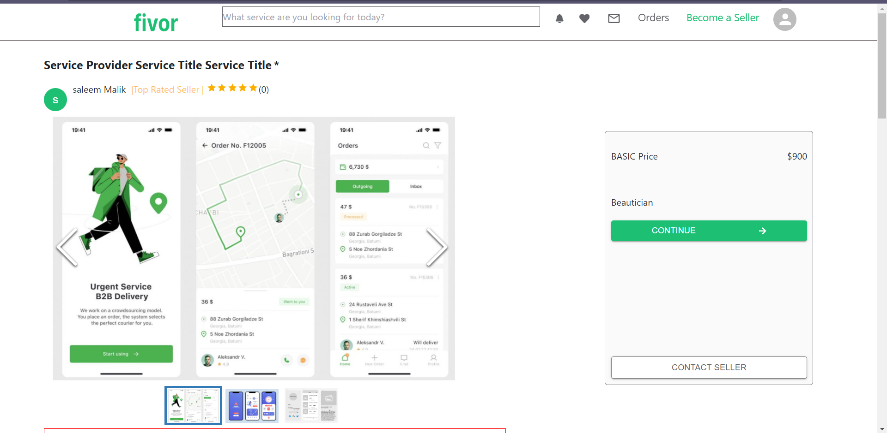
Frontend

Slide 13
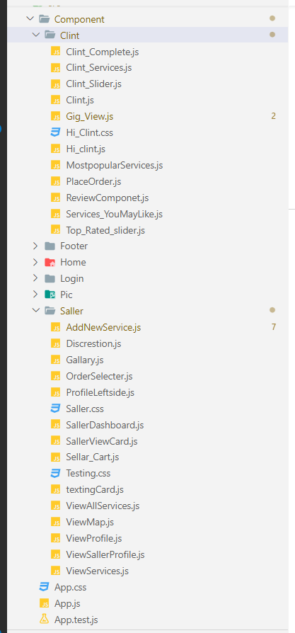



Frontend Directory Structure
Components
Styles
Public/Images

Slide 14
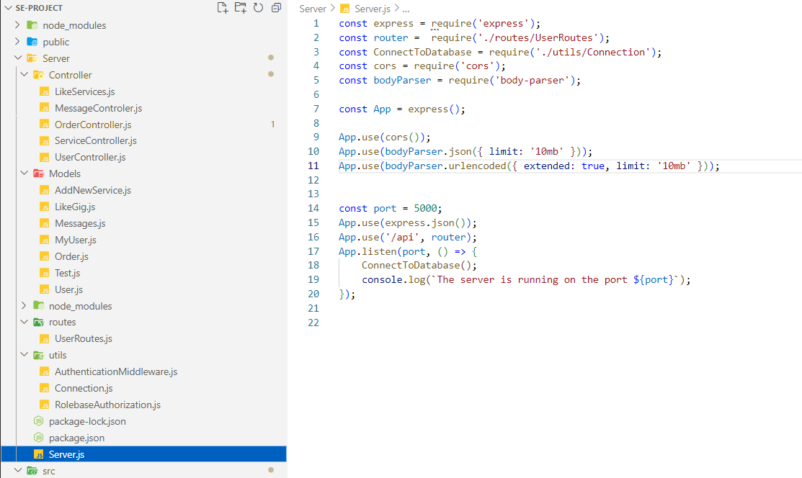
Backend
Node JS
Express API
MongoDB

Slide 15
Backend
Node JS
Express API
MongoDB

Slide 16
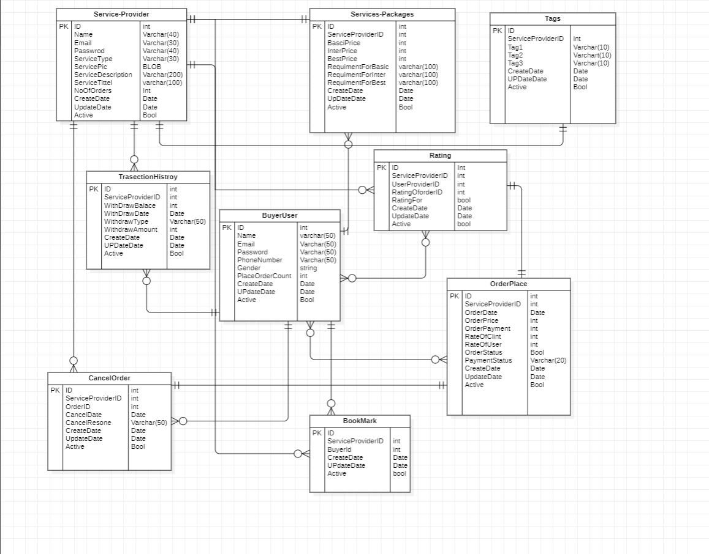
Database Schema

Slide 17
Any Question

